Slide 1
PLACEMENT PORTAL
Presented by
Saket Agarwal
MCA – III
41111604416

Slide 2
Introduction
Placement Portal is a web application which is made using Django and Python.
Using Placement Portal one can keep records all the placements, students and companies and can access anytime.
Placement Portal is accessible to multiple users at the same time.
Notes:
How presentation will benefit audience: Adult learners are more interested in a subject if they know how or why it is important to them.
Presenter’s level of expertise in the subject: Briefly state your credentials in this area, or explain why participants should listen to you.

Slide 3
Objective
Aim of this project is to keep records safe, easy to access, anytime, anywhere.
Reduce the paperwork.
Making process easier, simpler and faster.
Helping recruiters
Notes:
Lesson descriptions should be brief.

Slide 4
Operating Requirements
HARDWARE REQUIREMENTS
RAM : 1 GB or higher
Processor : 1GHz or higher
OPERATING PROCESSOR
Internet Browser
Notes:
Example objectives
At the end of this lesson, you will be able to:
Save files to the team Web server.
Move files to different locations on the team Web server.
Share files on the team Web server.

Slide 5
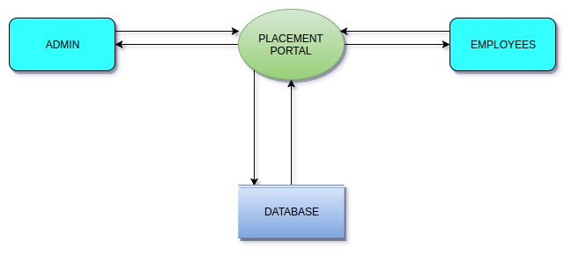
DATA FLOW DIAGRAM
LEVEL 0 / CONTEXT LEVEL

Slide 6
Data Flow Diagram
LEVEL I

Slide 7
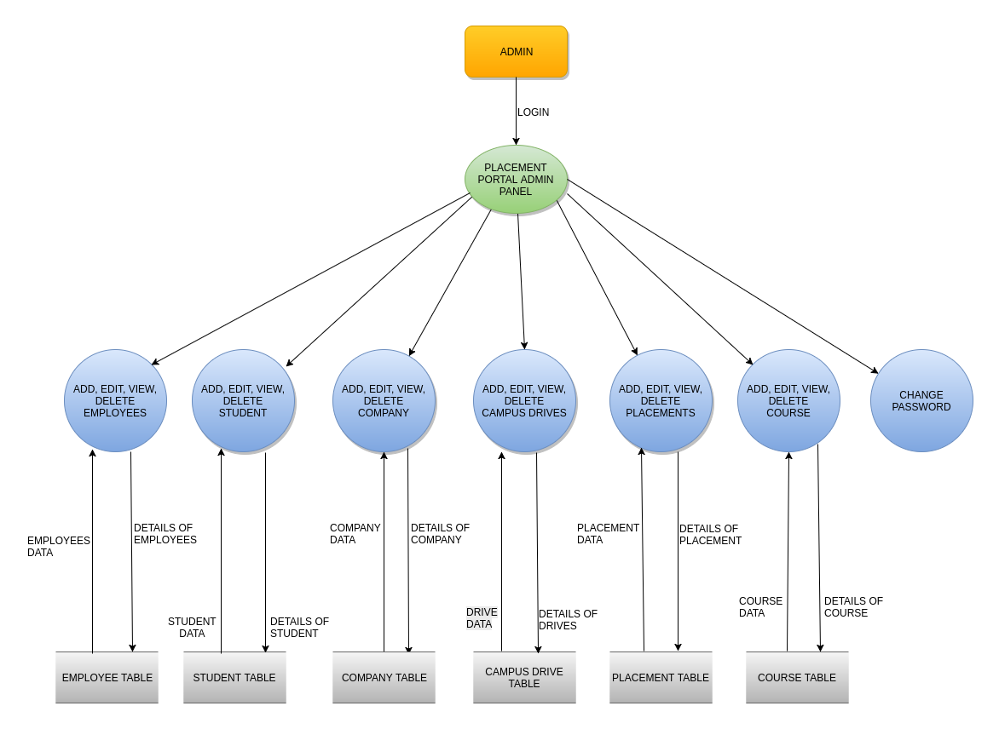

Slide 8
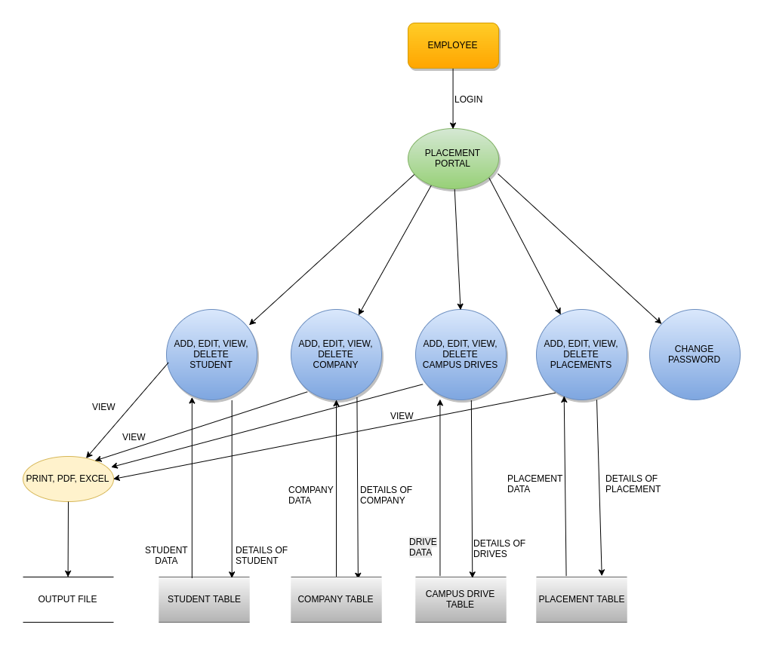

Slide 9
ER DIAGRAM

Slide 10
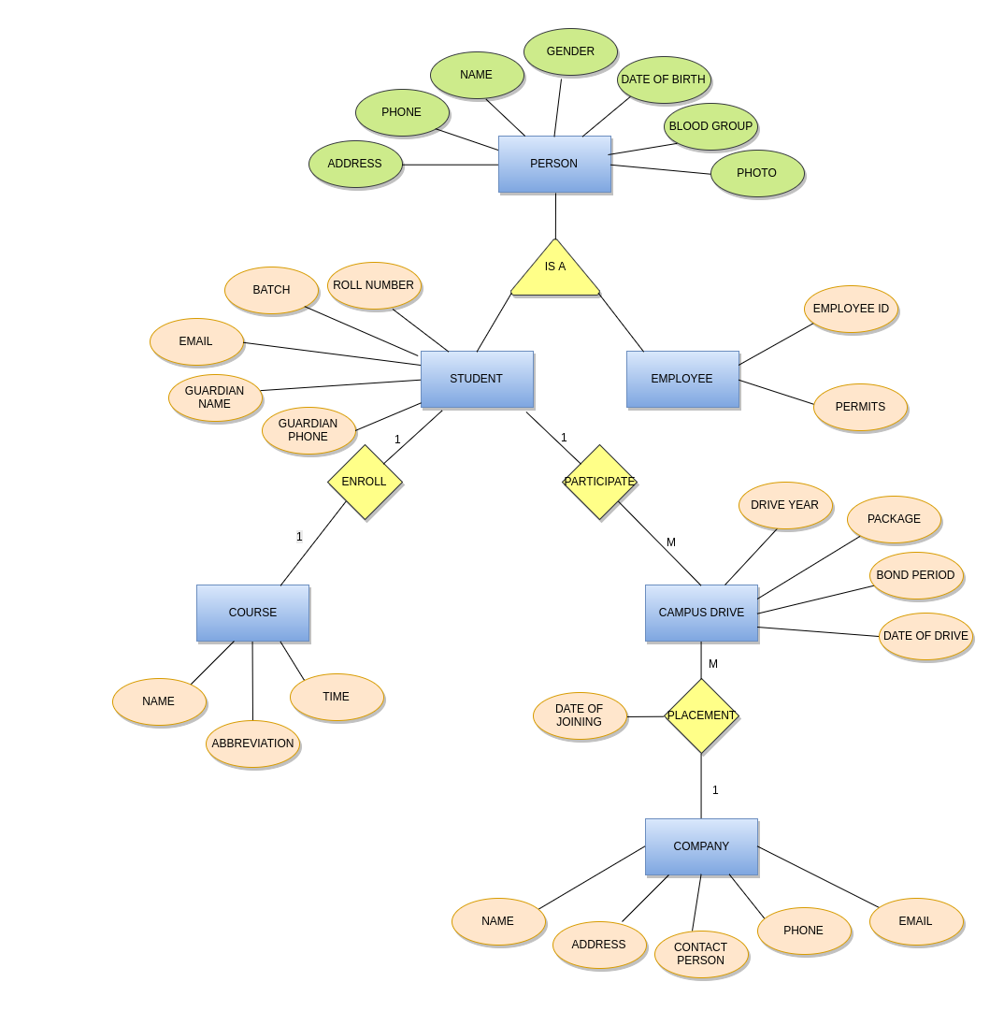

Slide 11
Future Scope
Extend this system to recruiters and students.
Data Analytics can be excluded.

